Slide 1

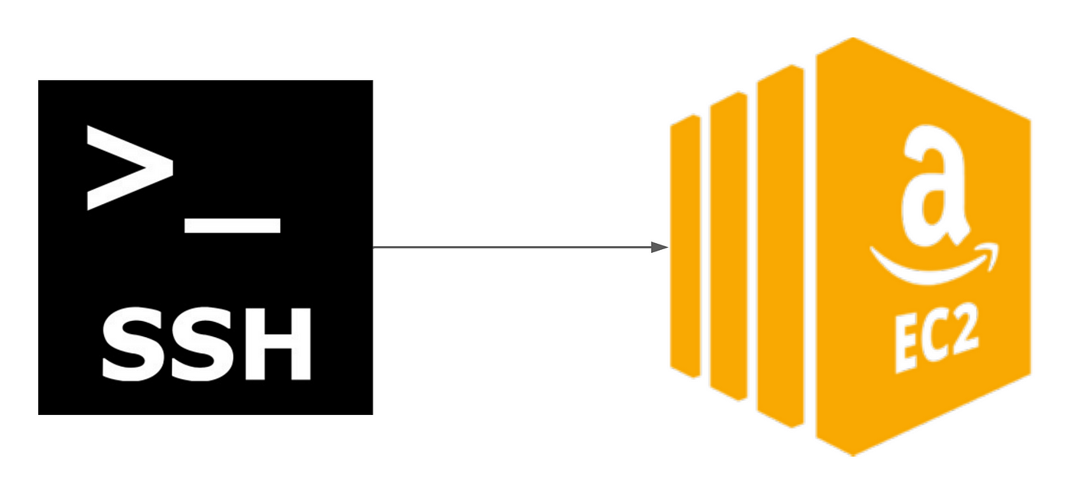

Slide 2
Data Analysis Using Aws-EC2
This Python data analysis project involves setting up a cloud-based environment on AWS. To manage access, an IAM user will be created with appropriate permissions for EC2 and S3. This user will be used to connect to a remote Gitbash instance via SSH for code development. While direct SSH connections without an IAM user are possible, a hybrid approach is preferred for better security and management. The project will leverage an EC2 instance for computational tasks and potentially utilize S3 for data storage based on project requirements.
Virendra Raikwar

Slide 3
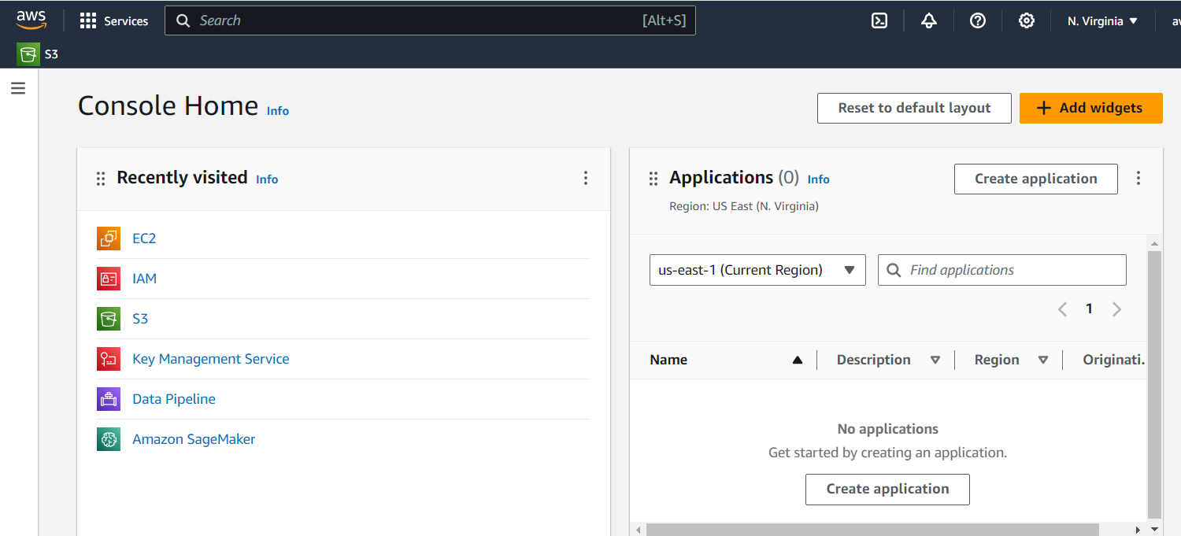
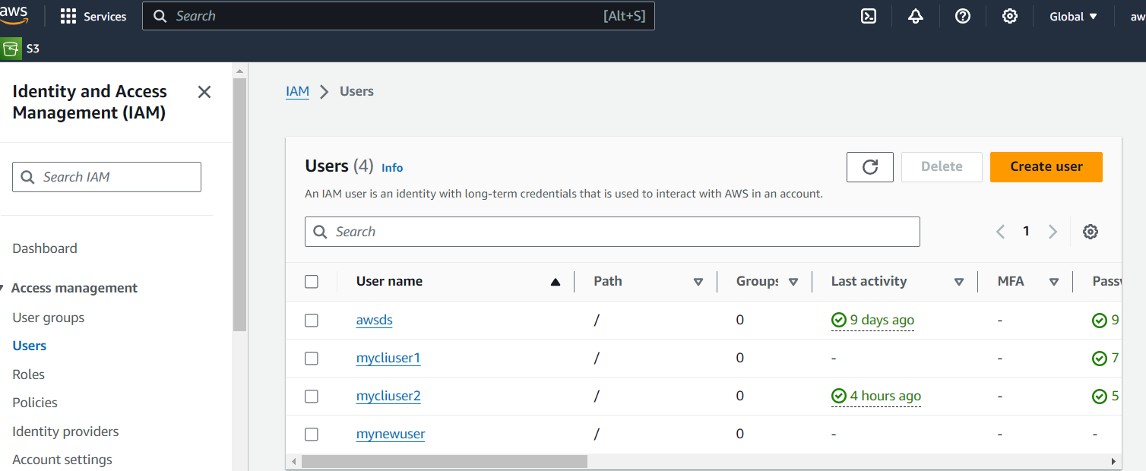
Creating an IAM user with restricted permissions based on specific use cases.
Aws Console Dashboard
Creating I AM user

Slide 4
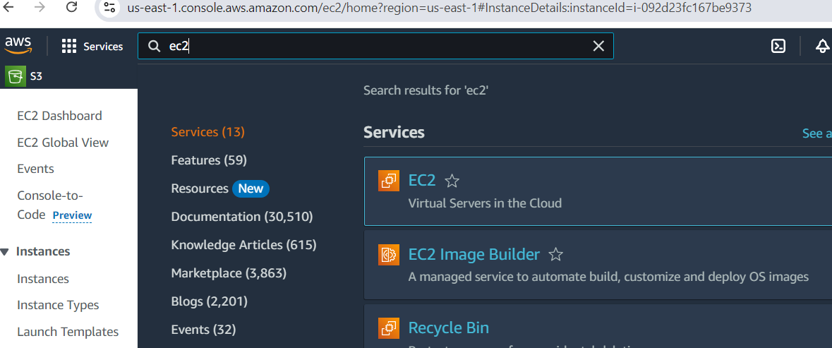

After creating an EC2 instance, download the key pair for SSH connection, and then connect to it using Git Bash.
Launching Ec2 instance
Ssh Connection

Slide 5
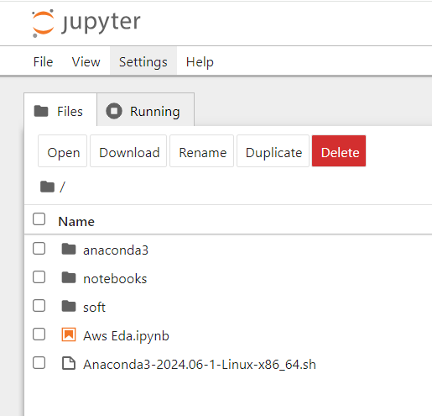
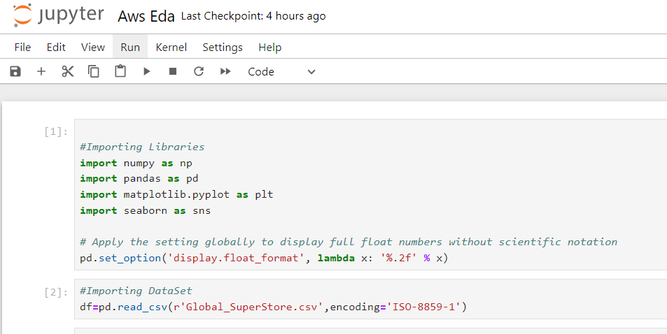
After establishing an SSH connection to the server, install and start Jupyter Notebook. Create a new notebook for data analysis.
Creating Jupyter Server
Opening Notebook

Slide 6
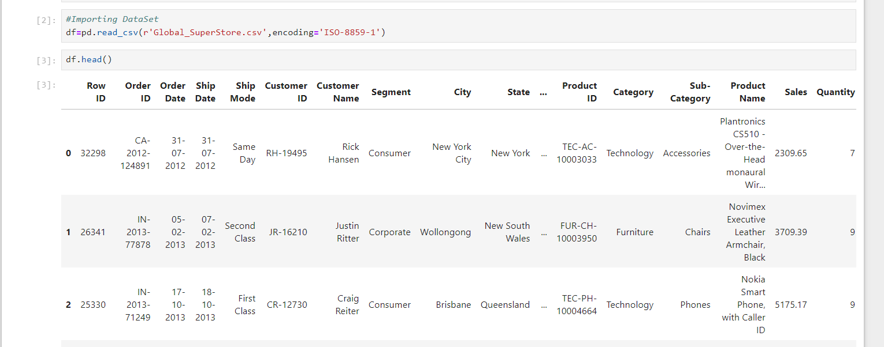
Reading GlobalSuperstore Data

Slide 7
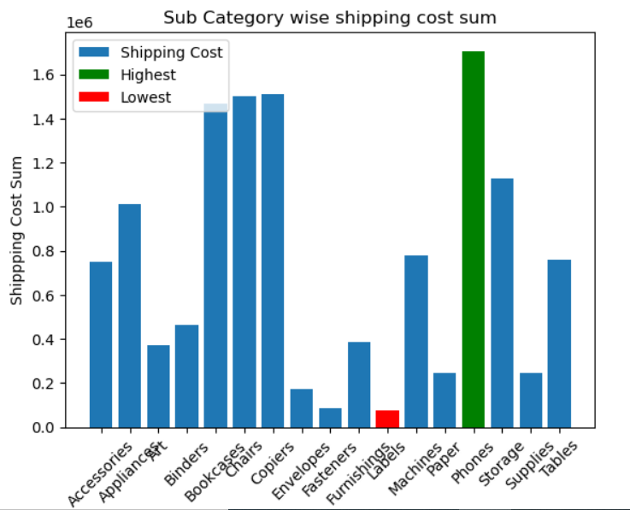
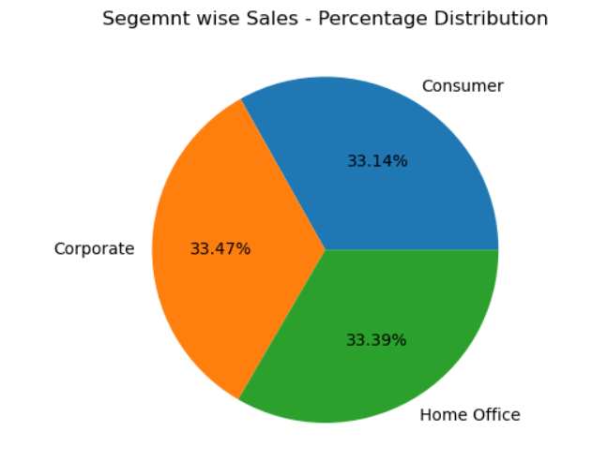
Here we can clearly see that the shipping cost is lowest for the furnishing subcategory and highest for phones. On the other hand, customer segments share approximately equal percentages across all three segments.
Sub Category Wise Shipping Cost Sum
Segment wise Sales-Percentage Distribution

Slide 8
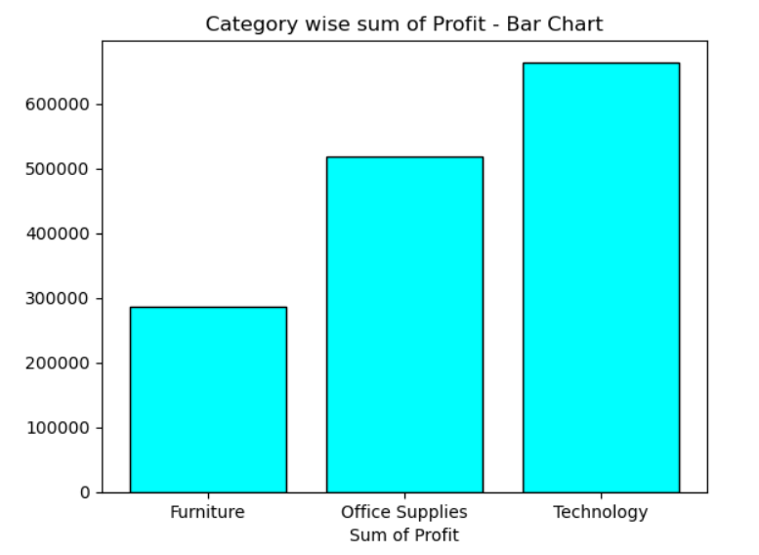
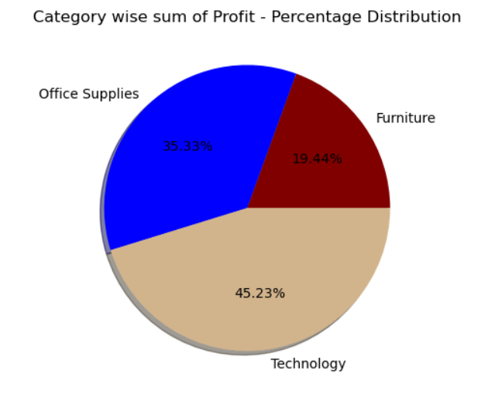
The chart shows that the technology category generates the highest profit compared to the other two. Profit percentage distribution is also highest for technology.
Sum of Profit
Percentage Distribution

Slide 9
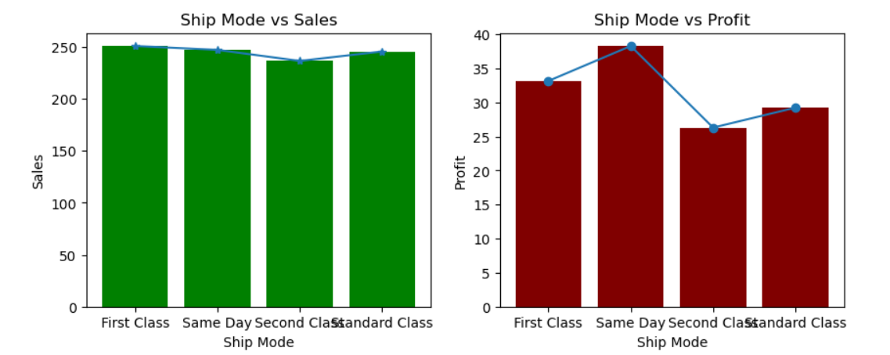
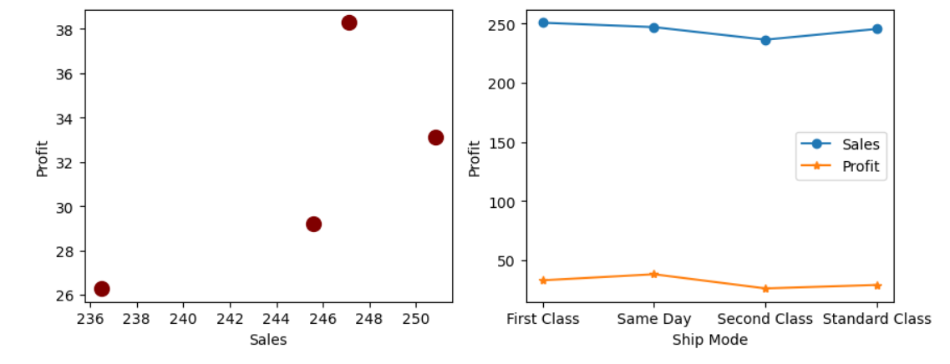
The charts illustrate the relationship between profit and both shipping mode and sales amount.
Ship Mode Vs Sales & Profit
Sales and Ship mode vs Profit

Slide 10
Github :-https://github.com/VirendraR2107
The aim of this project is to gain practical experience in working with cloud platforms, including data management and computational resources. Cloud computing is becoming increasingly essential due to rapidly changing technological landscapes. I will also be working on machine learning projects to enhance my data science skills, which will be valuable for my future career.
Thank You

